Slide 1

Predicting Repeat Customer Behavior
Chidiebere Odurukwe
Notes:
Good morning/afternoon, [David, and all Executives present]. Thank you for this opportunity. I'm Frances Odurukwe, and today, I'm excited to share how our WAKFLO solution can transform your customer retention story. Imagine turning one-time shoppers into loyal advocates that drive sustainable growth. We'll explore the challenges, key insights from our analysis, and how this tool delivers real results for your bottom line.

Slide 2
Table of content
Executive Summary
The Problem – Wakflo Customer Story
The Solution
The Approach – Finding The Hidden Clues
The Discoveries – Key Drivers of Customer Loyalty
Choosing the Right Tool - Accuracy & Transparency
The Wakflo Prediction Tool
How the Tool Fits Into the Business - Prediction > Action > Repeat (Funnel)
Notes:
As you can see from the agenda, we'll start with a quick executive summary to set the stage, then walk through the customer challenge and our solution. I'll highlight the discoveries that make this work, show the tool in action with a live demo, and end with recommendations and the business impact—including ROI. This keeps us focused on actionable insights for your strategy. Any questions before we begin?

Slide 3
Table of content conts…
Live Demo
Recommendations
Business Impact
ROI Gains
Benefits Wheel
Customer Journey
Conclusion & Next Steps
Q&A

Slide 4

Executive Summary
The Challenge:
A “leaky bucket”
My Solution:
Predictive model + web tool for marketing & sales.
Bottom Line:
Retention - estimated +10-15%
Assumptions:
Stable market trends (2023 – 2025). Validated with 99% holdout accuracy, PSI <0.1 for stability and monthly Chi-Square checks.
Notes:
Let's jump right to the heart of it: Your business faces a a common but costly issue a ‘leaky bucket’—many first-timers don’t return, costing revenue. WAKFLO’s predictive tool spots loyalty early, aiming for 10-15% retention growth. It’s built on 10,000 records from 2023-2025, assuming stable trends, and validated with 99% accuracy on test data. We use PSI under 0.1 and monthly Chi-Square checks to keep it reliable for your strategy and to adapt forecasts
Your business faces—a 'leaky bucket' where many first-time customers don't return, draining potential revenue. Our solution? A predictive model paired with an interactive tool that spots loyalty patterns early, helping marketing and sales act proactively. The bottom line: Expect a 10-15% retention boost, based on validated insights from 10,000 customer records. We assume similar behaviors continue, but with 99% accuracy on test data and monthly updates, this is a reliable path to predictable growth for your vision

Slide 5
The Problem
Cost: Acquisition vs Retention
500
400
It costs more to acquire new customers than to retain existing ones
300
Cost per customer ($)
200
100
Acquire New Customer
Retain Existing Customer
Notes:
Now, let's frame the story through your lens as CEO. You acquire plenty of new customers, but too few stick around, making growth feel unpredictable.

Slide 6
The Problem
We acquire many new customers — but too few become loyal.
It costs more to acquire new customers than to retain existing ones
Notes:
Treating everyone the same wastes resources, it is inefficient and costly.—it's 5-7 times more expensive to replace a customer than to retain one.. And with 65% of sales coming from repeats, , yet many are slipping away unnoticed.
this churn silently erodes your revenue and frustrates your teams. Customer churn silently erodes revenue.
It costs 5–7x more to replace a
65% of sales come from repeat customers

Slide 7

Core Question:
How do we spot the future loyalists among first-time buyers?
Notes:
The core question? How do we identify future loyalists among these first-timers? Without answers, your strategies rely on guesswork, but that's where our story turns. Executives want predictable revenue, but blind spots in retention prevent it.

Slide 8

The Solution
AI-driven prediction model with a 99% accuracy.
Notes:
Enter WAKFLO—AI-driven prediction model identifies customers likely to return or churn. your predictive partner that analyzes customer behaviors to forecast who will return. It highlights patterns like spending habits and engagement, turning data into a clear story of loyalty. Why does this work for you? It shifts from reactive fixes to proactive wins, aligning with your goals for efficient marketing and steady revenue. No complexity—just reliable insights that empower your team to nurture relationships early and effectively. Delivers insights that enable proactive engagement and optimized marketing spend. No technical complexity – results are visual, actionable, and immediate.

Slide 9
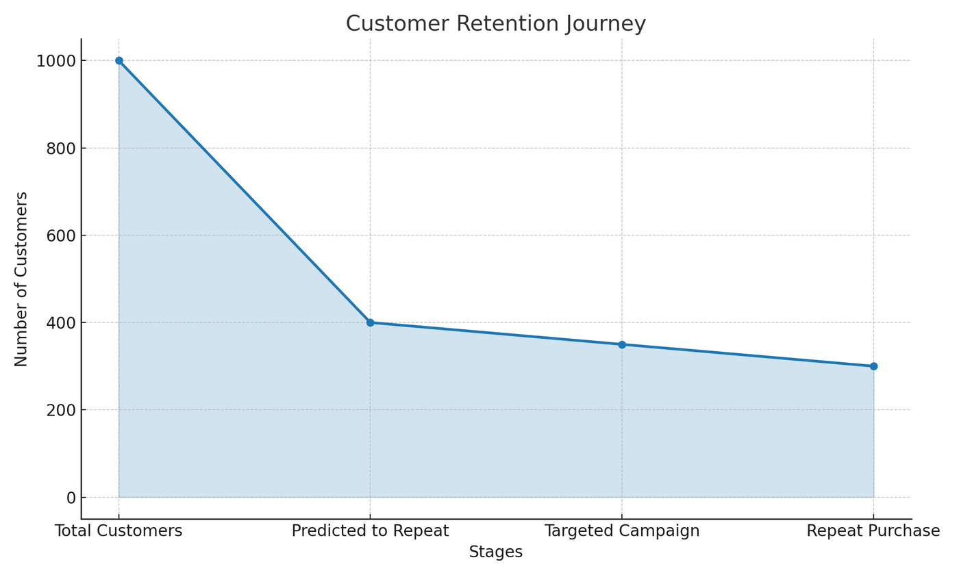
The Solution
Notes:
Enter WAKFLO—your predictive partner that analyzes customer behaviors to forecast who will return. It highlights patterns like spending habits and engagement, turning data into a clear story of loyalty. Why does this work for you? It shifts from reactive fixes to proactive wins, aligning with your goals for efficient marketing and steady revenue. No complexity—just reliable insights that empower your team to nurture relationships early and effectively

Slide 10
The Discoveries – Key Drivers of Customer Loyalty
Past Behavior
Engagement
Satisfaction
Commitment
Notes:
To uncover these insights, I started by exploring your customer data—looking at behaviors and segments to spot what drives repeats. Then, I built a model to recognize those loyalty patterns reliably. Finally, I created an interactive tool that delivers actionable results instantly. This methodical approach ensures we're not guessing; we're using proven clues from your data to guide decisions that matter to your business. These insights mean you can act early to retain high-value customers, turning one-time buyers into revenue engines. Past Behavior → Total Number of Purchases (strongest signal—higher purchases mean they're invested in your brand)
Engagement → Email & social interactions (early clues to building lasting relationships).
Satisfaction → Average Satisfaction Score (early warning - happy customers stick around longer).
Commitment → Premium Membership status

Slide 11
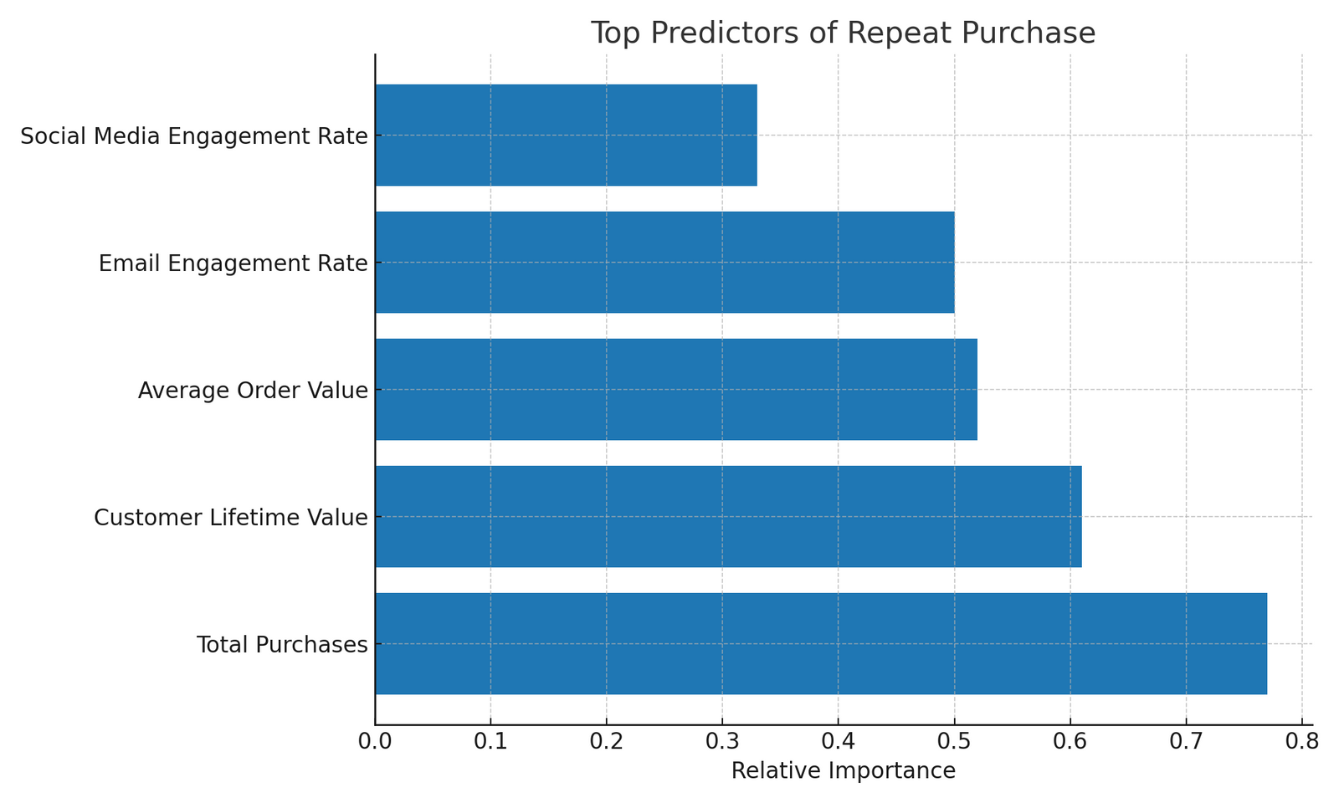
The Discoveries
Notes:
From this chart before us, we can see the top predictors of repeat purchase directly pulled from the dataset.

Slide 12
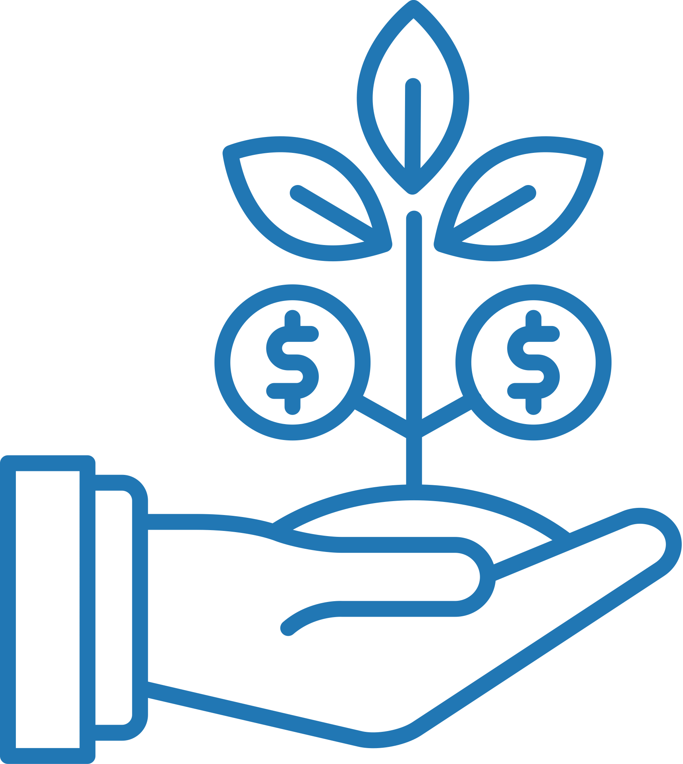


Choosing The Right Tool – Accuracy & Transparency
Purchase History
Engagement Rates
Satisfaction Scores– CLV
Notes:
From the analysis, three main drivers stood out: First, past behavior like total purchases—it's the strongest signal because customers who've bought more are already invested in your brand. Second, engagement through emails and social—early interactions hint at building lasting ties. Third, satisfaction scores act as an early warning; happy customers are far more likely to return. These insights mean you can act early to retain high-value ones, turning potential churn into revenue opportunities. Purchase History: strongest loyalty signal (customers with more buys are primed for repeats). Engagement Rates – email & social interaction correlates with return likelihood (guides targeted actions). Customer Lifetime Value – high CLV customers deserve retention focus (predicts long-term value).

Slide 13
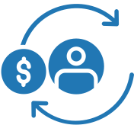
Choosing The Right Tool – Accuracy & Transparency
Why It Works: Focus on variables you can influence for higher ROI; validated with 99% accuracy on unseen data, ensuring trustworthy business decisions.
Notes:
Why It Works: Focus on variables you can influence for higher ROI; validated with 99% accuracy on unseen data, ensuring trustworthy business decisions.

Slide 14
Wakflo Prediction Tool – Scenario 1
Notes:
Now, let's see the tool in action. [Pause to launch demo].

Slide 15
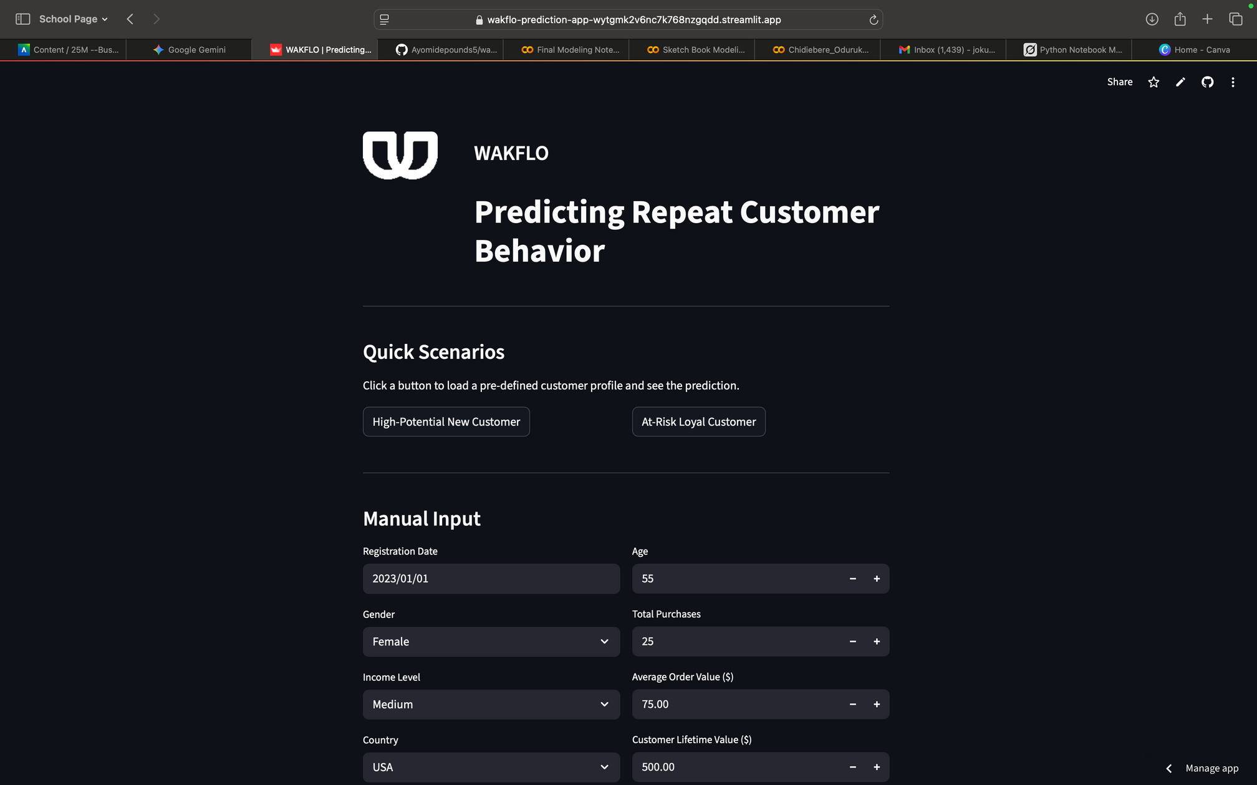
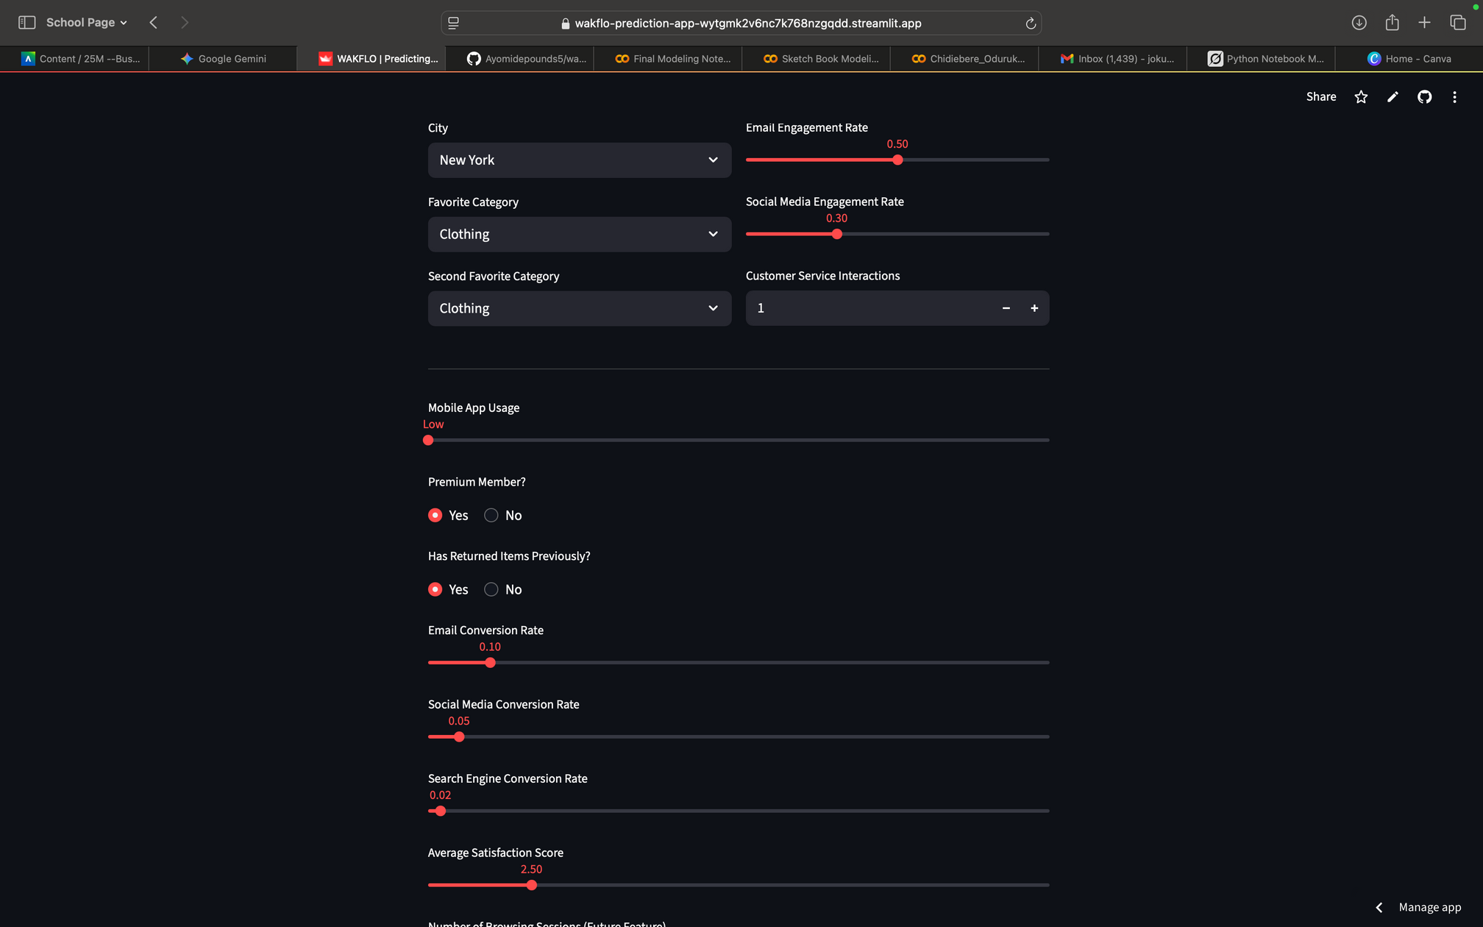
High-Potential New Customer → Engage with premium membership offer.
Notes:
This dashboard takes your customer data and scores them on repeat potential—high, mid, or low. For example, in Scenario 1: A high-potential new customer with strong purchases gets flagged for premium perks.

Slide 16
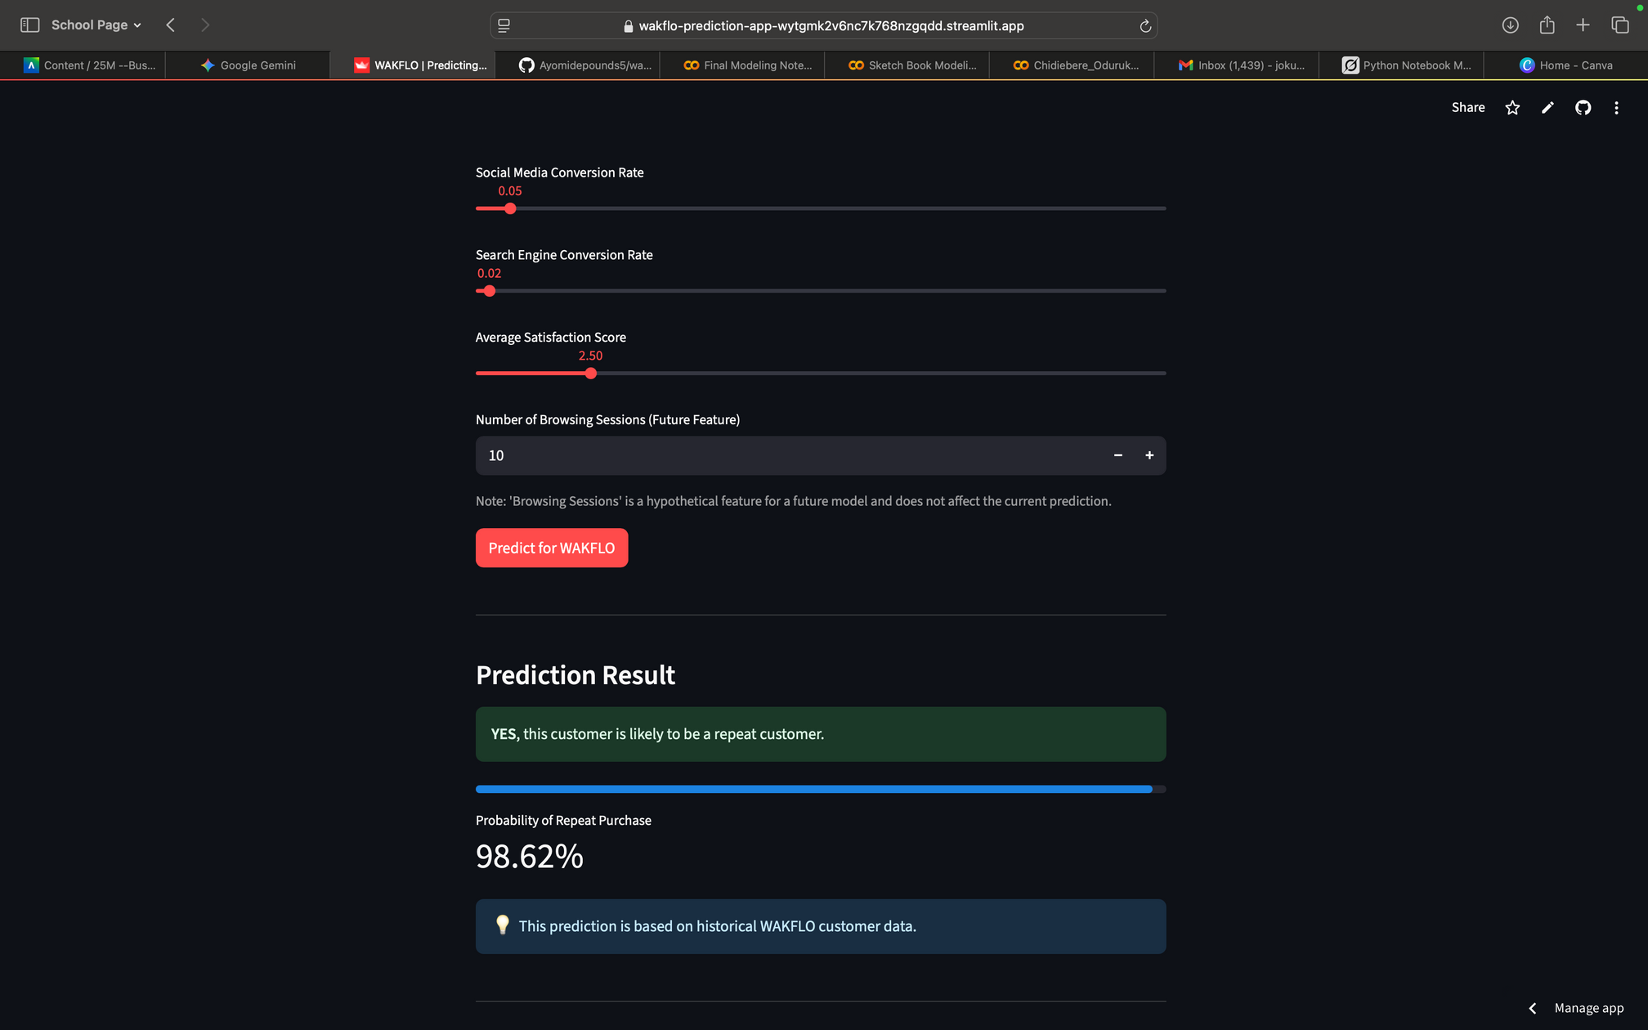
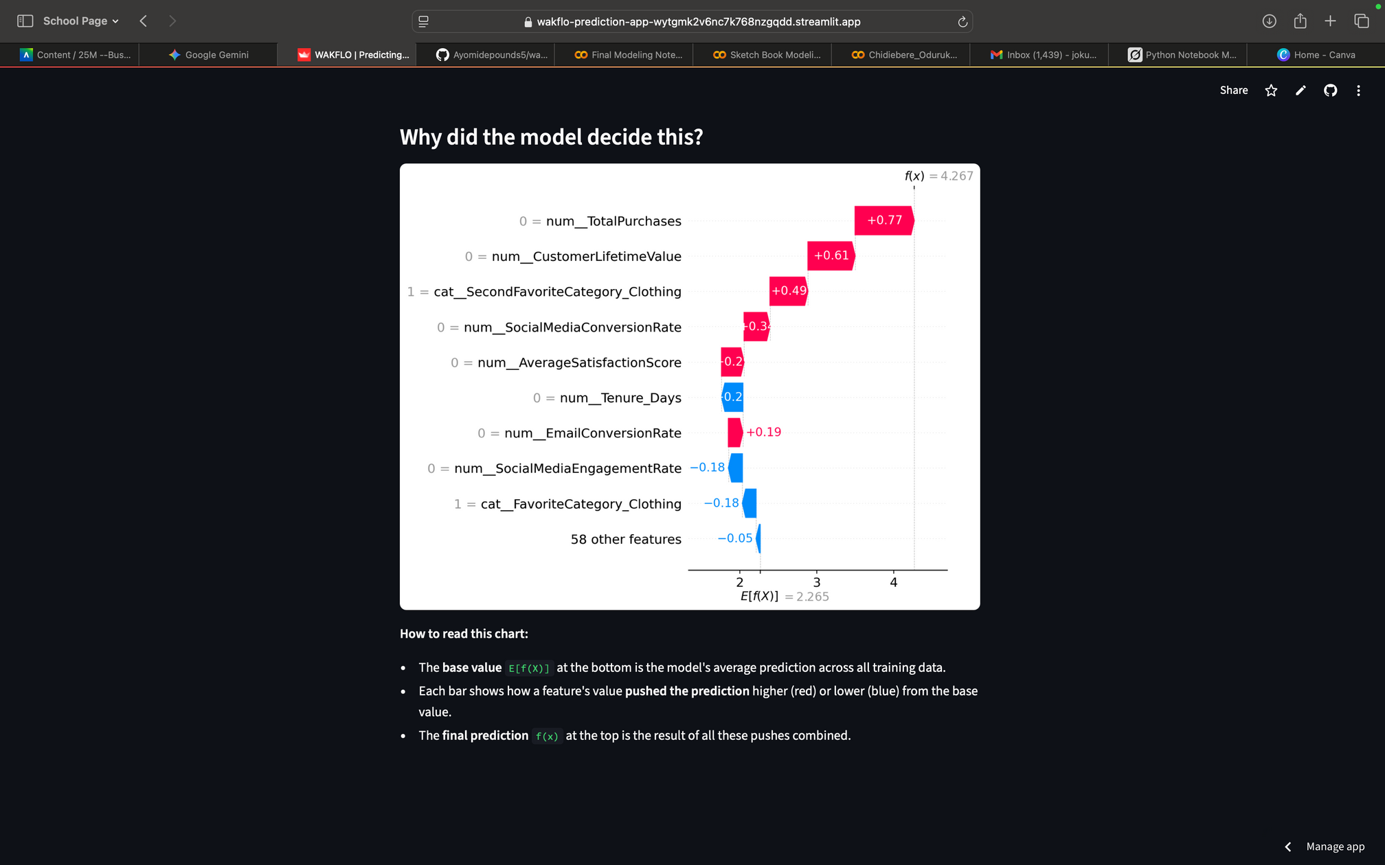
High-Potential New Customer → Engage with premium membership offer.

Slide 17
Wakflo Prediction Tool – Scenario 2

Slide 18
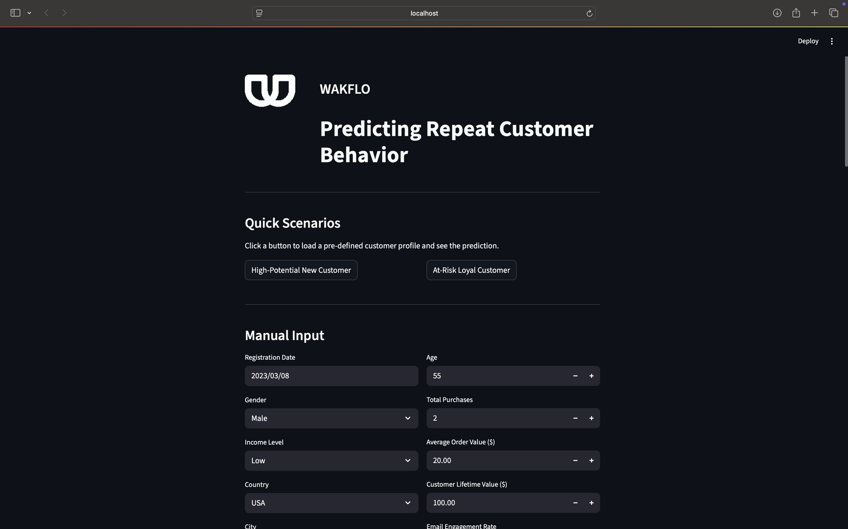
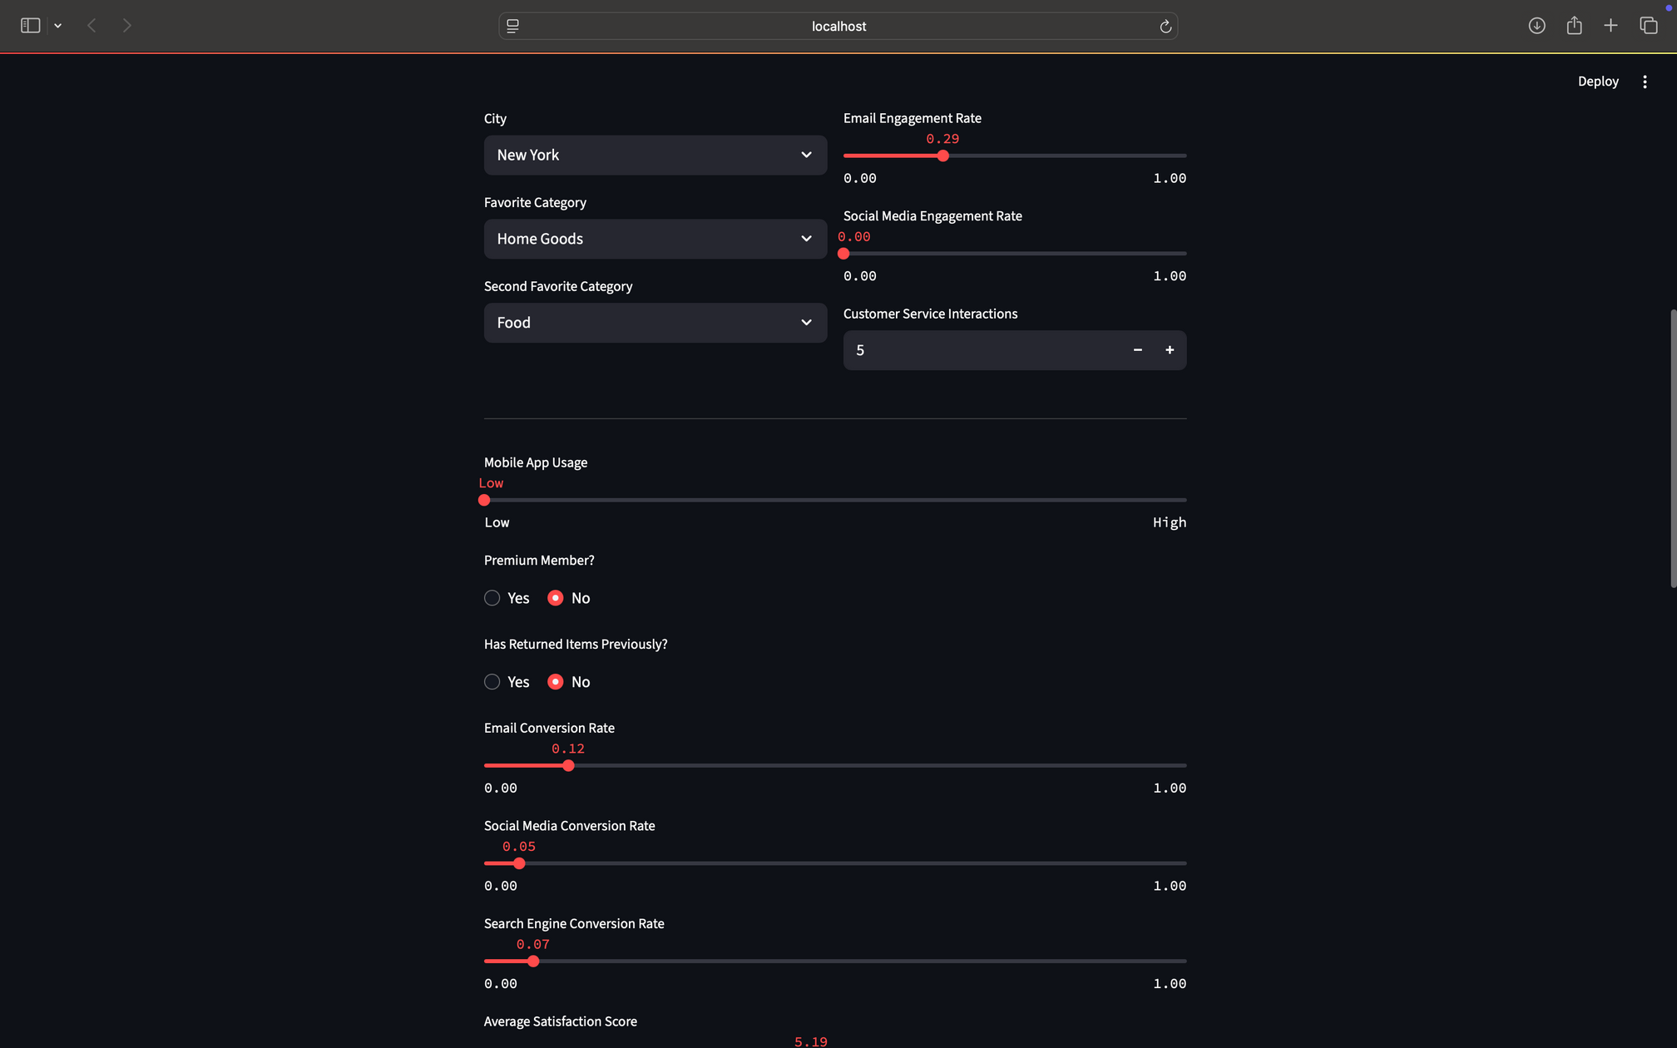
At-Risk Loyal Customer → Proactive outreach to save the relationship.
Notes:
Scenario 2: An at-risk loyal one with dropping engagement triggers a re-engagement email. It's simple, visual, and ties directly to actions that boost your retention—let's walk through a quick live example with sample data.

Slide 19
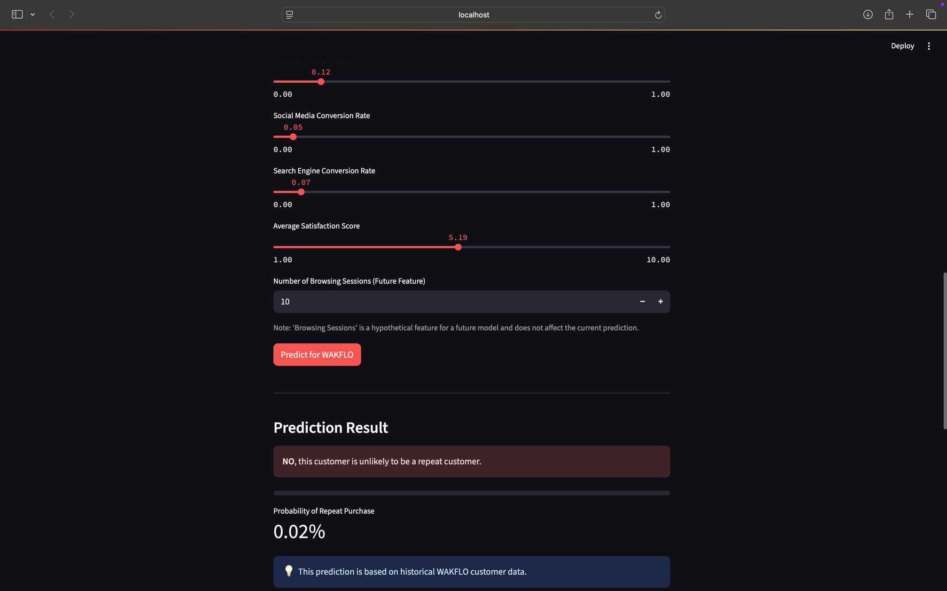
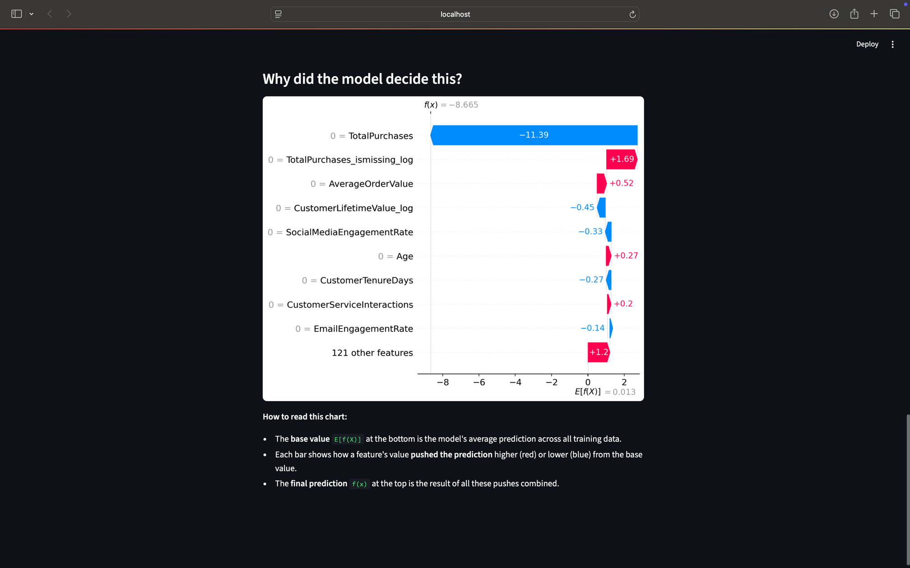
At-Risk Loyal Customer → Proactive outreach to save the relationship.

Slide 20
How The Tool Fits Into The Business
Prediction → Targeted Action → Repeat Purchase
Prediction
Targeted Action
Repeat Purchase
Notes:
Here's how it fits your operations: The tool predicts based on those key drivers, then guides actions like targeted campaigns, funneling customers from one-time buyers to repeats. For instance, a prediction of 'high potential' leads to personalized offers, resulting in higher loyalty. This creates a seamless funnel that optimizes your marketing spend and turns insights into real revenue growth—directly supporting your strategic priorities. The tool also, helps you Focus resources on the customers who matter most — at the right moment.
Being an Interactive dashboard for marketing & sales, it proves it’s reliability to perform as well as generate revenue.
While Turning predictions into actions instantly, it also, turns your data into a profit funnel, driving revenue growth.

Slide 21
Recommendations
High-Potential (>80%) → Nurture with exclusive perks.
On-the-Fence (50–80%) → Personalized campaigns to drive the next purchase.
At-Risk (<50% or sudden drop) → Customer success outreach to resolve issues.
Customer Success Story – ROI Impact
Before
After
200
150
Cost per customer ($)
100
50
Retention Rate
CLV Metrics
Marketing Efficiency
Notes:
During my research, I heard this customer success story about a mid-size e-commerce client that ran a 3-month pilot, Identified at-risk high-value customers, Implemented targeted offers & engagement and BOOM!!! The Results: Retention went up to ↑ 22%, CLV ↑ 18%, Marketing spend efficiency ↑ 30%.
Based on these insights, here are my top recommendations: First, prioritize high-potential segments with tailored emails and loyalty programs to lock in repeats. Second, monitor at-risk customers monthly with re-engagement tactics, like discounts tied to their satisfaction scores. Third, integrate this into your CRM for real-time alerts. These steps are low-effort but high-impact, designed to align with your goals for efficient, data-driven growth. Next Phase → Integrate model with marketing automation for scale.
Prioritize high-potential segments with tailored offers to boost our retention goals.

Slide 22
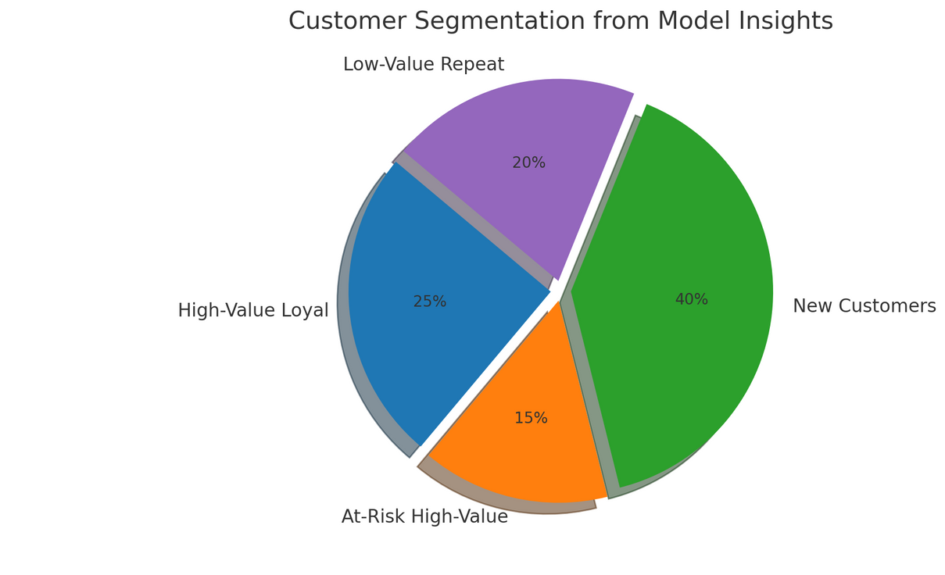
Business Impact
Increase overall retention by an estimated 10–15% in Year 1
01 Segmentation & Benefits
(High-value loyal, at-risk high-value, new, low-value repeat).
Higher CLV | Lower Churn | Better ROI | Stronger Brand.
Notes:
Implementing this delivers clear wins: Through segmentation, Segment customers to target strategies effectively. you'll target high-value loyal, at-risk, new, and low-value repeats more effectively. Expect 10-15% retention growth in Year 1, ; direct outcomes → Higher CLV, increased revenue, lower acquisition costs.
leading to higher customer value, reduced churn, better marketing ROI, and a stronger brand. Plus, secure data handling ensures compliance, with monthly updates for sustained impact—minimizing risks while maximizing your long-term vision

Slide 23
ROI Gains: Before vs After
Retention Rate, CLV, and Marketing Efficiency improvements post-implementation.
Usage Trends & Behaviors
Notes:
This isn't hypothetical—it's the proven path to your growth targets, driven by focusing on dependable predictors like spending habits ($5,000 revenue lift in real terms).

Slide 24
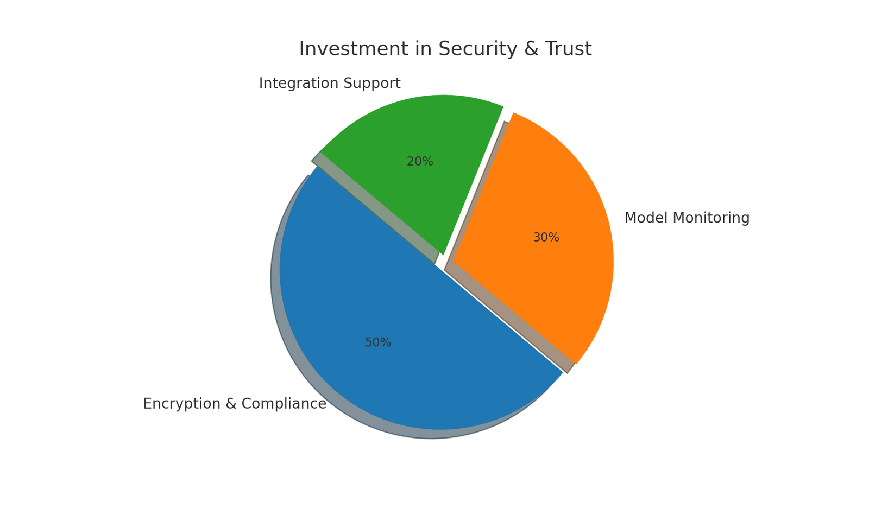
Addressing Your Concerns
Data Security
Model Governance
Ease of Integration
Notes:
Your data is fully encrypted and GDPR-compliant, with anonymization at every step—same rigor you’d expect, ensuring trust as you scale retention. Data Security: Fully encrypted, anonymized, compliant with industry standards.
Model Governance: Regular monitoring & retraining to prevent drift.
Ease of Integration: Works with CRM and marketing tools seamlessly.

Slide 25
Conclusion & Next Steps
Go Proactive
The Why
Move from reactive to proactive retention with transparent actionable predictions
More Data
Understand the ‘why’ behind customer behavior (e.g. high purchases signal loyalty you can nurture)
First step towards a more data driven customer-centric Wakflo
Notes:
In conclusion, WAKFLO moves you from reactive churn fixes to proactive loyalty building with transparent predictions. It's the first step to a data-driven, customer-centric future—understanding 'why' behaviors drive repeats so you can act confidently. Let's tailor this to your data in a 30-min demo; book by Aug 15 for priority. What's your next move?

Slide 26
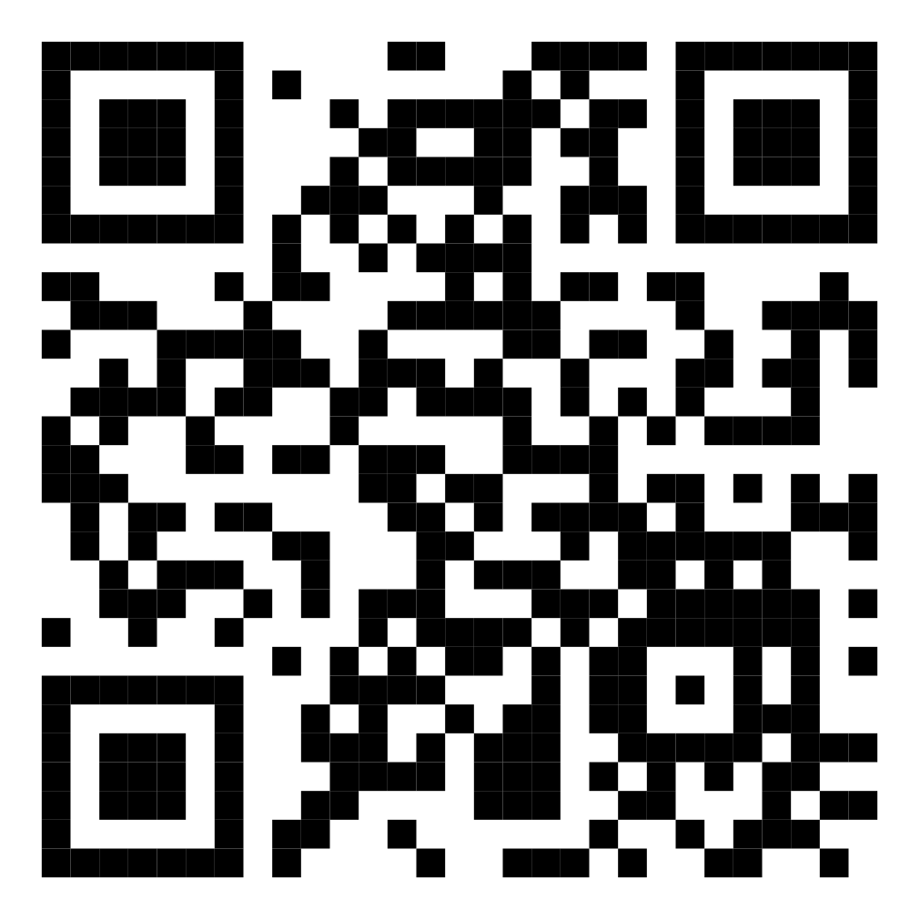
Try The Web App
Code Repo
wakflo-prediction-app
https://github.com/Ayomidepounds5/wakflo-prediction-app
https://wakflo-prediction-app-wytgmk2v6nc7k768nzgqdd.streamlit.app
Scan The QR Code
Notes:
To get started, scan the QR or contact me at frances@wakflo.com or (123) 456-7890. Let's schedule that demo and see how this unlocks your retention potential. Your growth story awaits!

Slide 27


Meet The Team
Frances Odurukwe
David Parent
Business Analytics Engr
CEO
I’m Frances Odurukwe — passionate about turning data into stories that drive growth. With a background in business analytics and project management, I help teams understand customers better, make smarter decisions, and build lasting relationships. I thrive where insight meets action.
An accomplished analytics leader known for building high-performing teams and delivering value through innovation, quality, and efficiency. Experienced in launching and leading programs, driving change across business and technical areas, and excelling in analytics, data management, and process automation.
Notes:
For the team behind this: As your Business Analytical Engineer, I'm passionate about turning data into actionable stories for growth. Thank you for your time—feel free to ask questions. Whether it's integration, costs, or customization, I'm here to address how this fits your vision.

Slide 28

THANK YOU
Feel free to ask questions.

